Slide 1
Installing and Configuring Microsoft Hyper-VR2
Name: Kulbir Singh Dhindsa
Gurinder Singh Kang
Navdeep Devgan
Manpreet Singh

Slide 2
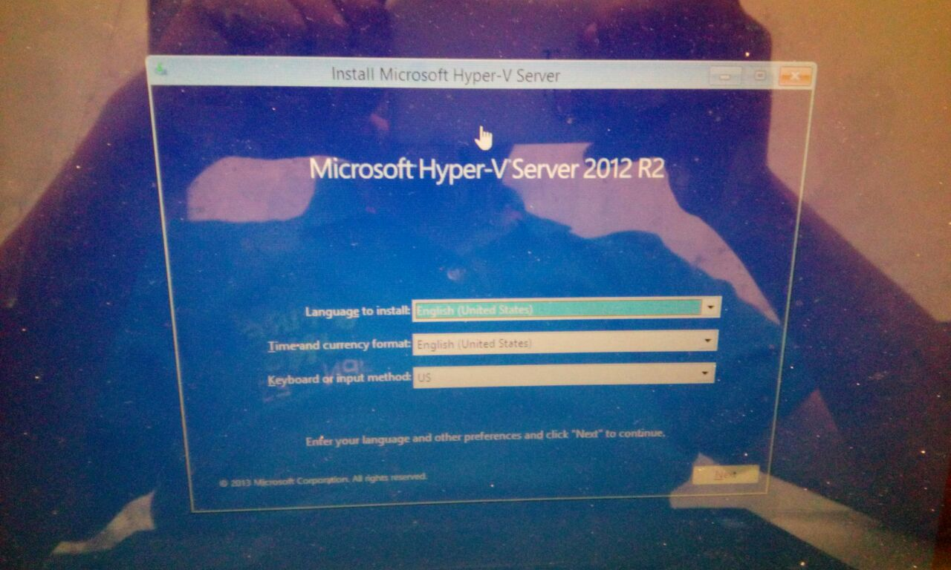
First insert MS Hyper-v- Server 2012 R2 CD to install it, Select your language and time zone.

Slide 3
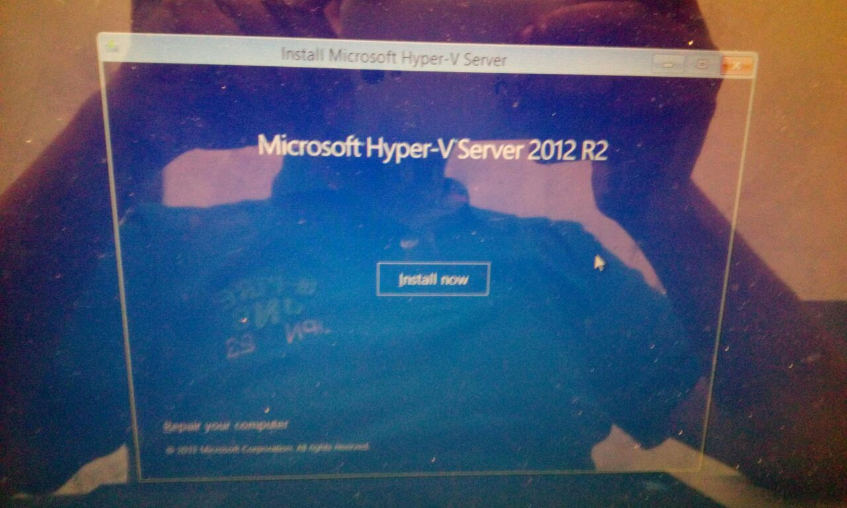
Click on install now to begin.

Slide 4
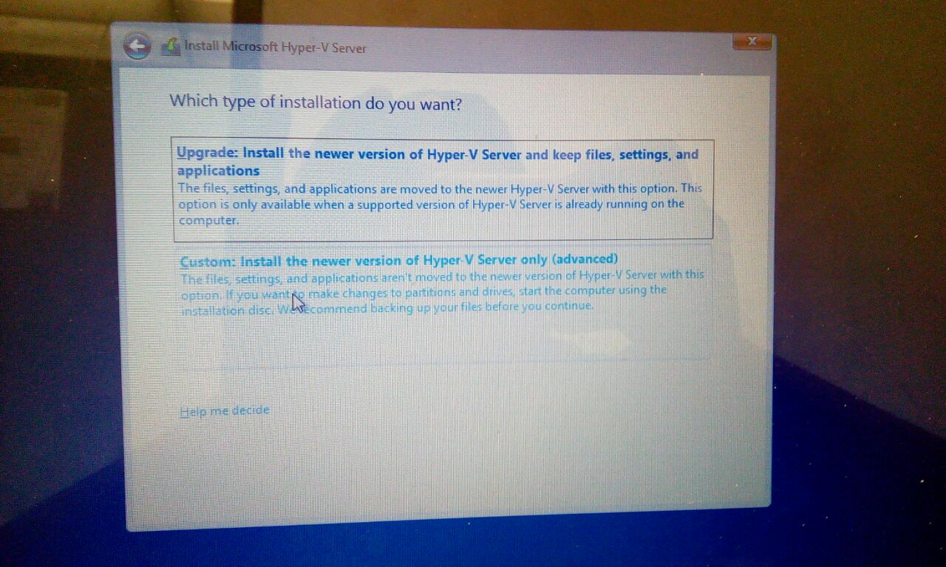
Select custom install option.

Slide 5
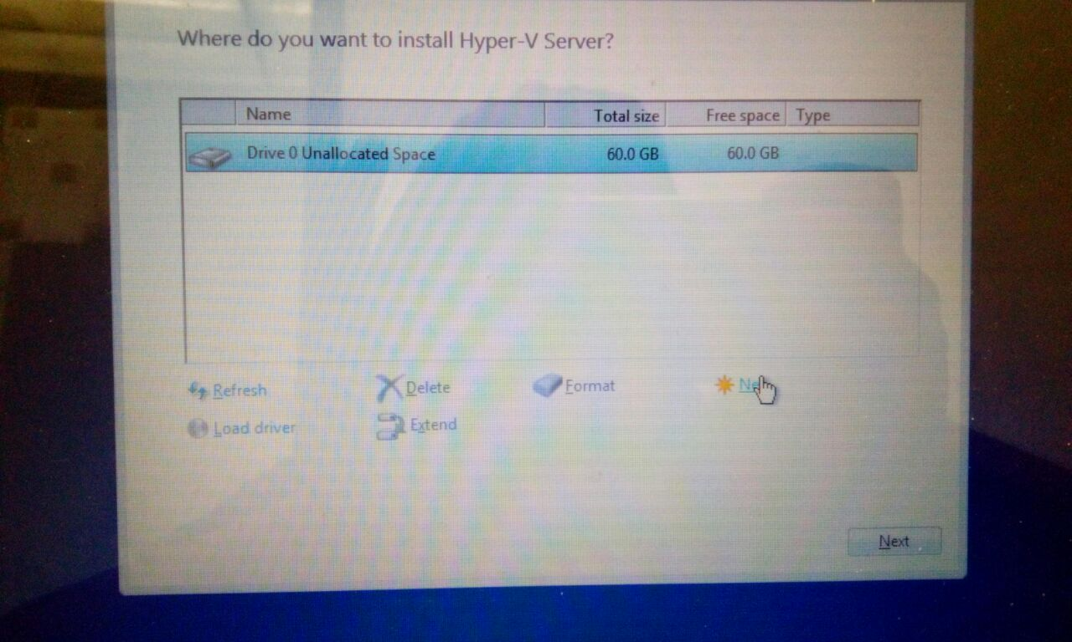
Select the drive or create a new partition wherever you want to install Hyper-V in your Pc and press Next button to continue.

Slide 6
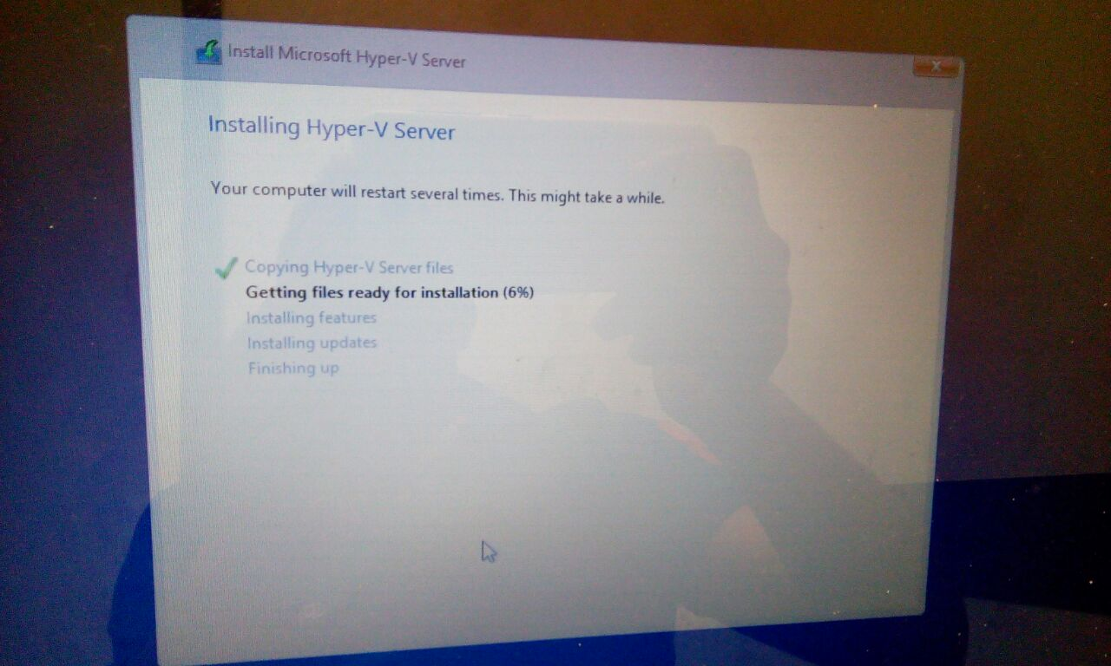
Setup will start copying the files to your Pc.

Slide 7
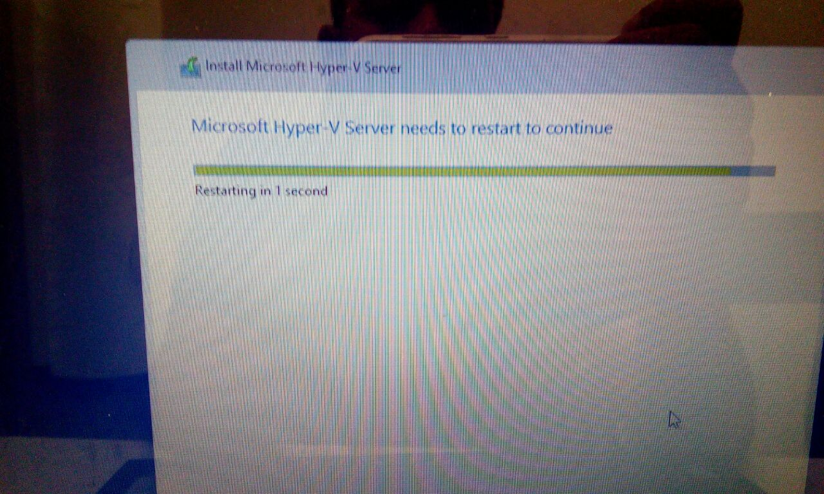
Your pc will reboot during installation process.

Slide 8
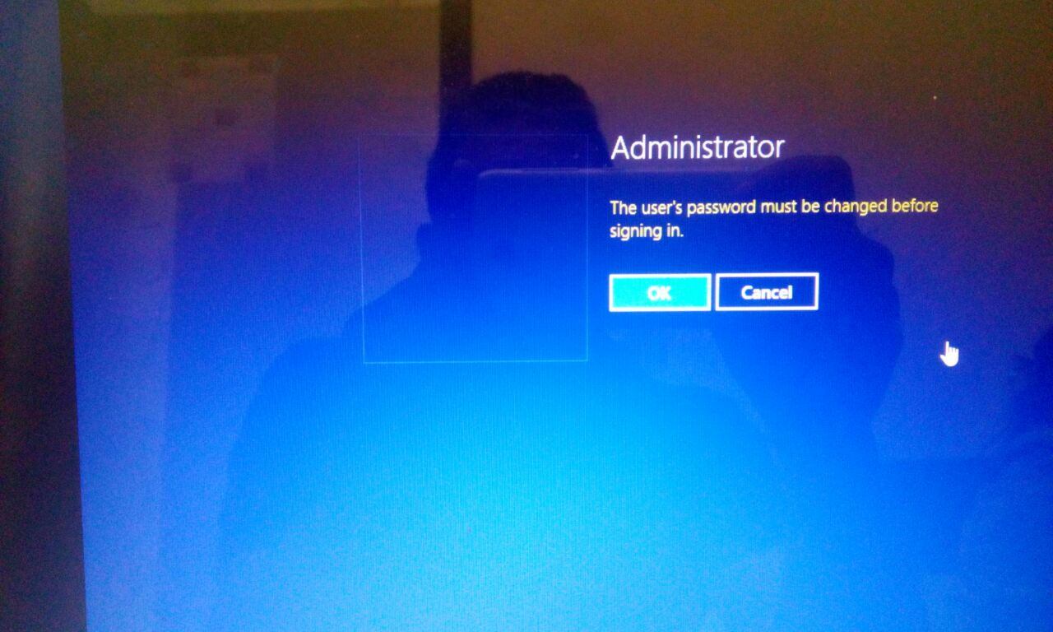
On Administrator Password option click ok to change your password before signing in.

Slide 9
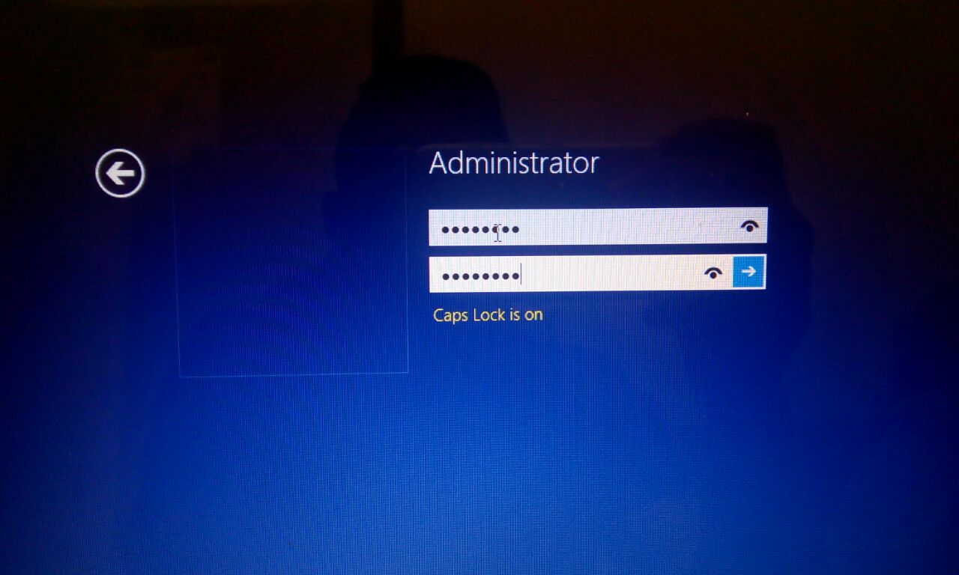
Type your new password and then continue.

Slide 10
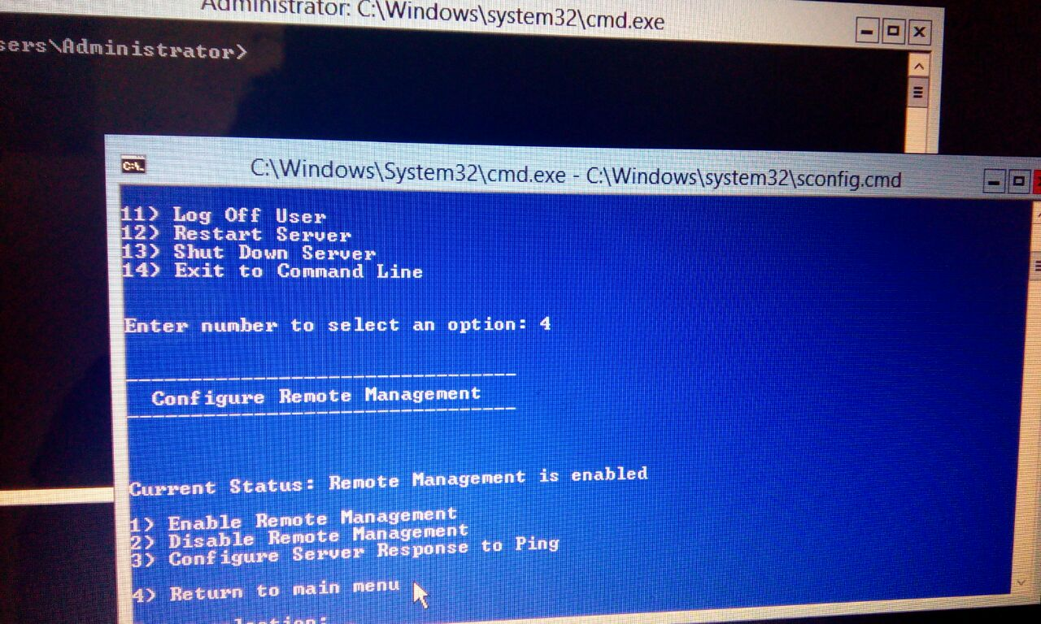
In server configuration enter number 4 to enter configure remote management option.

Slide 11
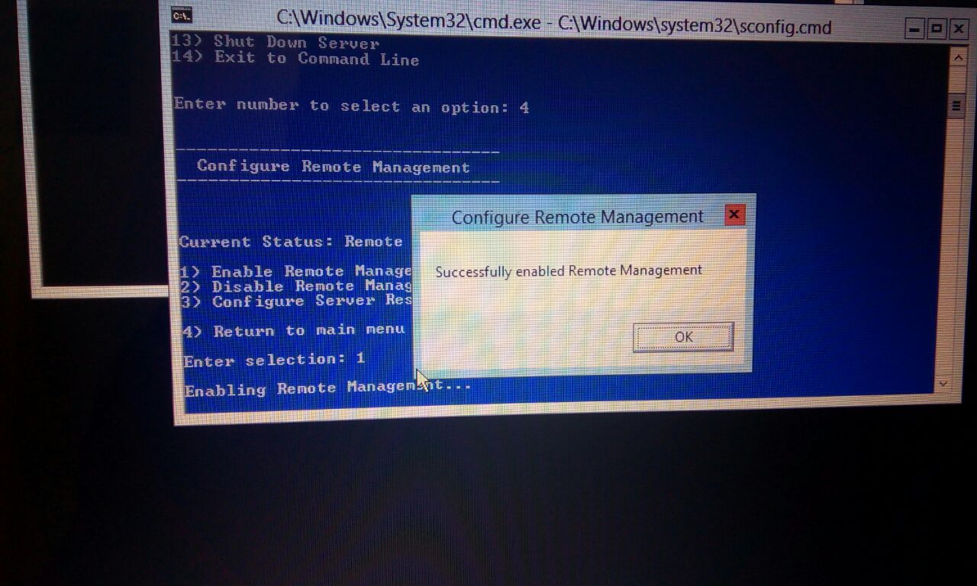
Again select first option and press OK to enable remote management.

Slide 12
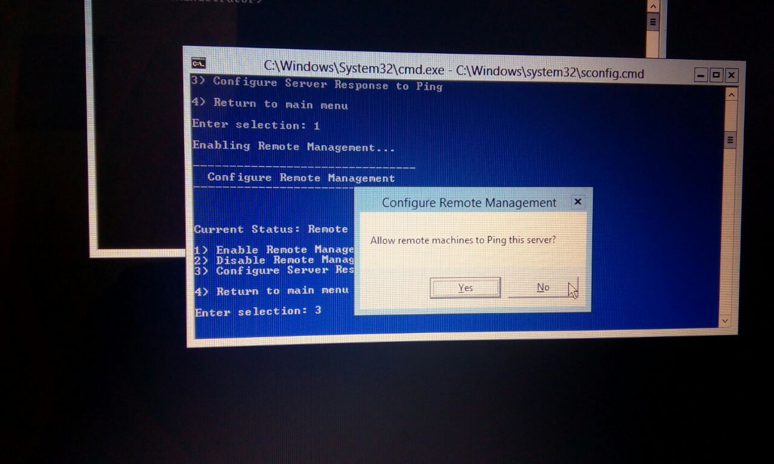
In pop up message press Yes to allow remote machines to Ping this server.

Slide 13
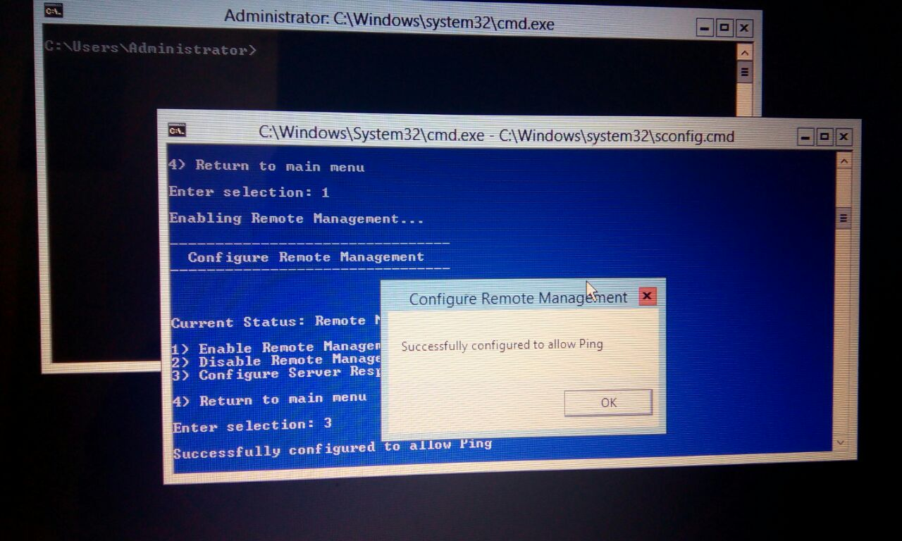
Press Ok to Finish and set it Ping command.

Slide 14
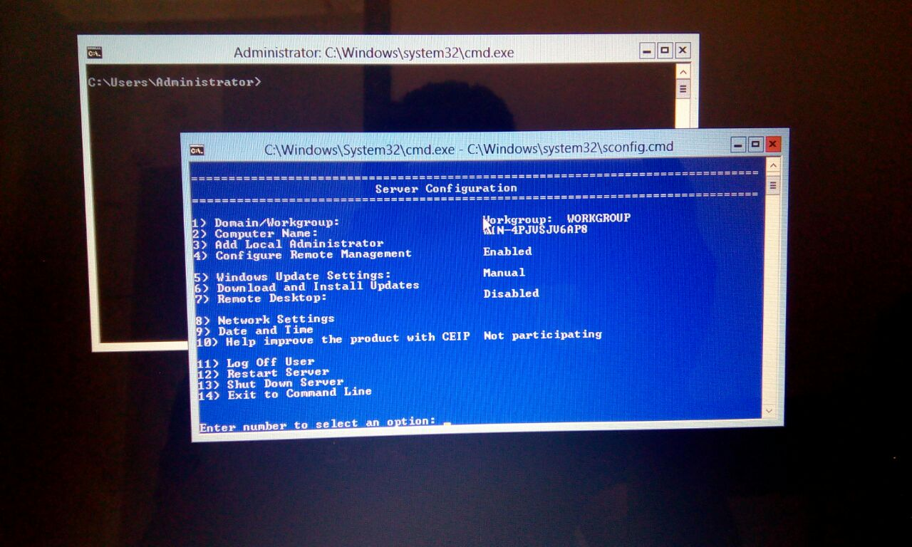
Enter number 4 to return to the main menu and select option 3 to go to Add Local Administrator.

Slide 15
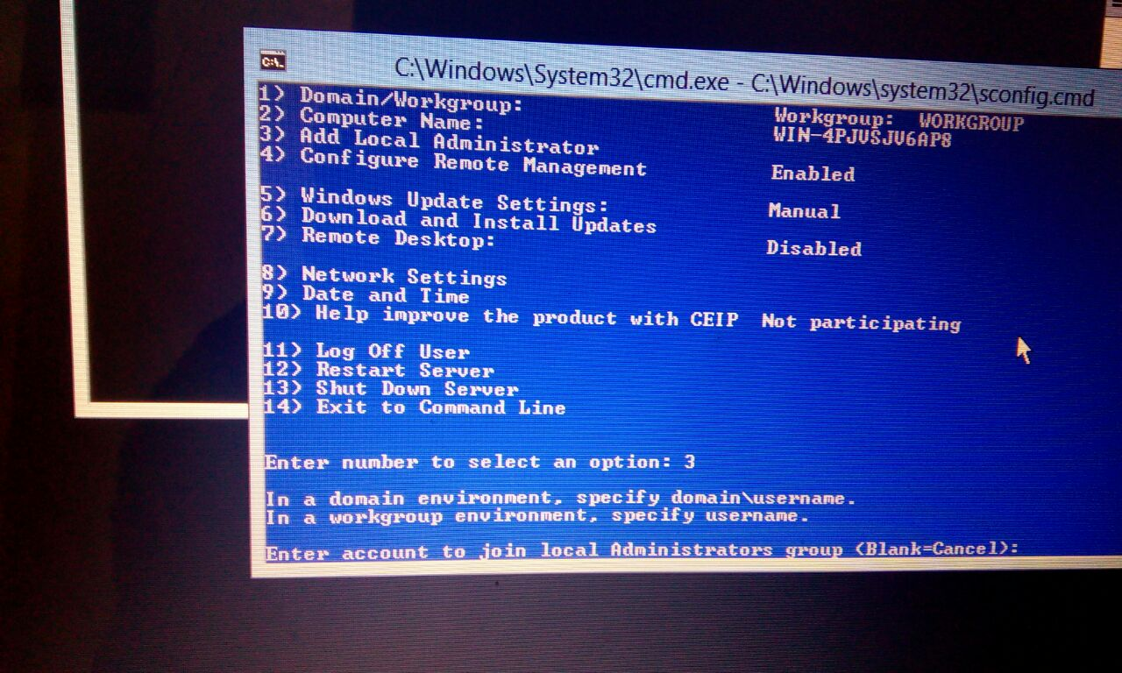
You have to enter your user name in Enter account to join local administrator group.

Slide 16
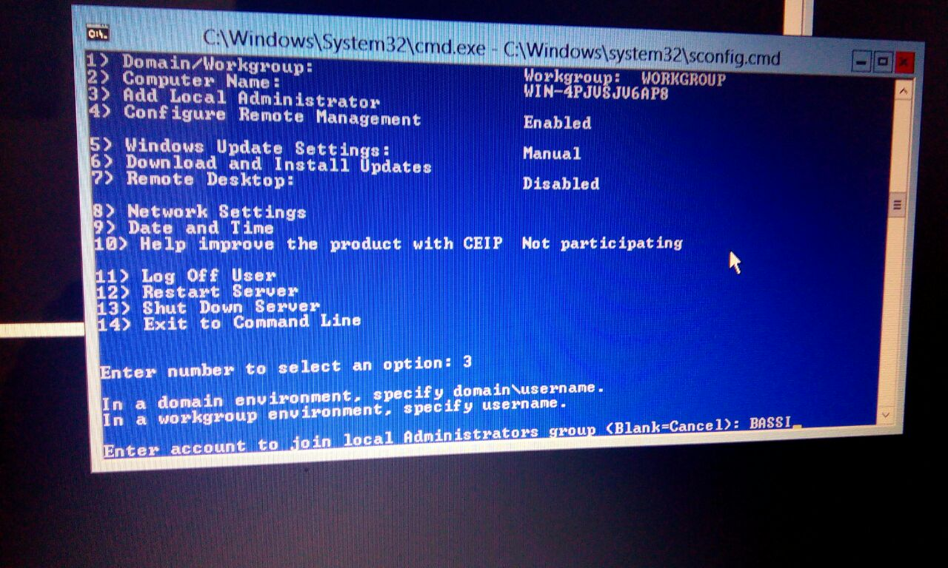
Enter your username, Bassi and then press enter.

Slide 17
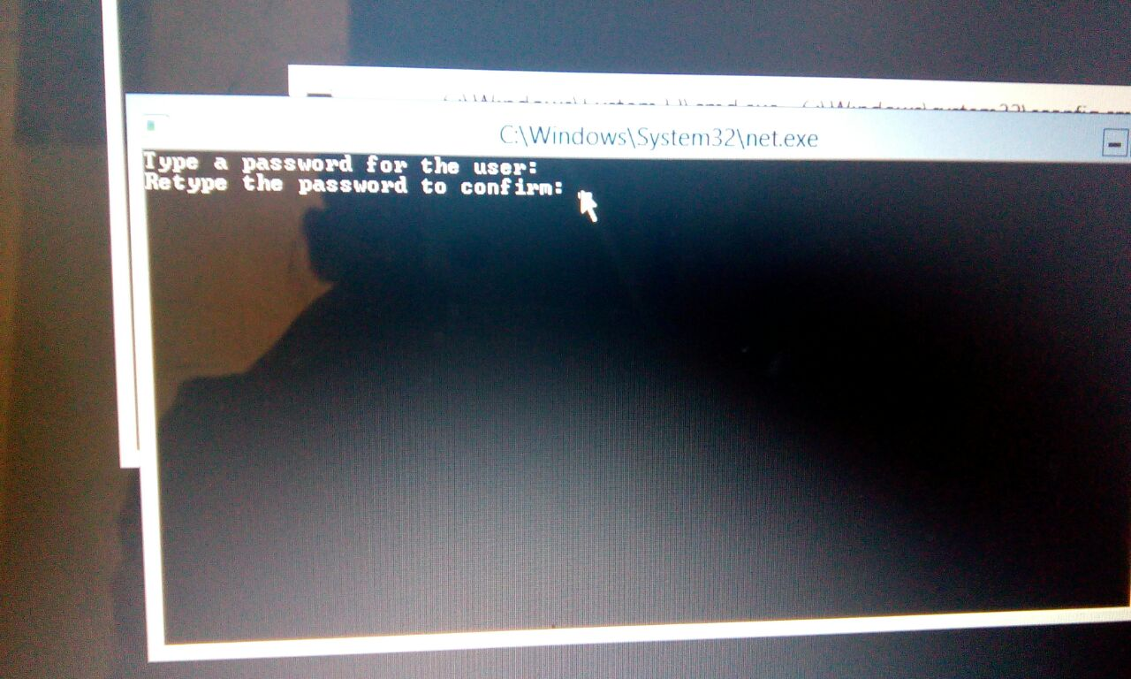
Type your password and confirm it again.

Slide 18
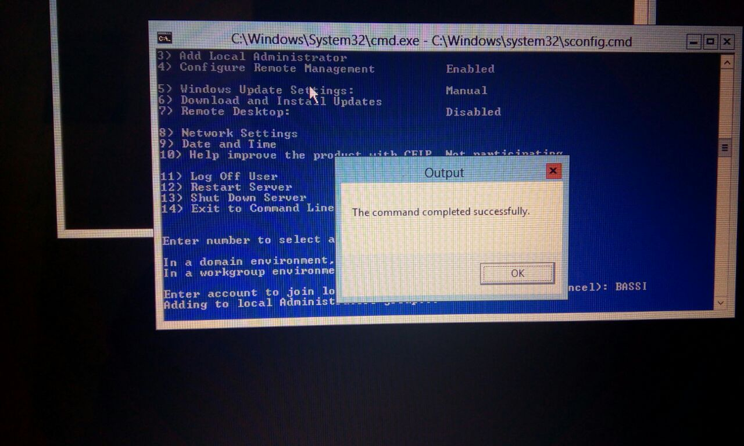
Typing in your user name password will complete this command.

Slide 19
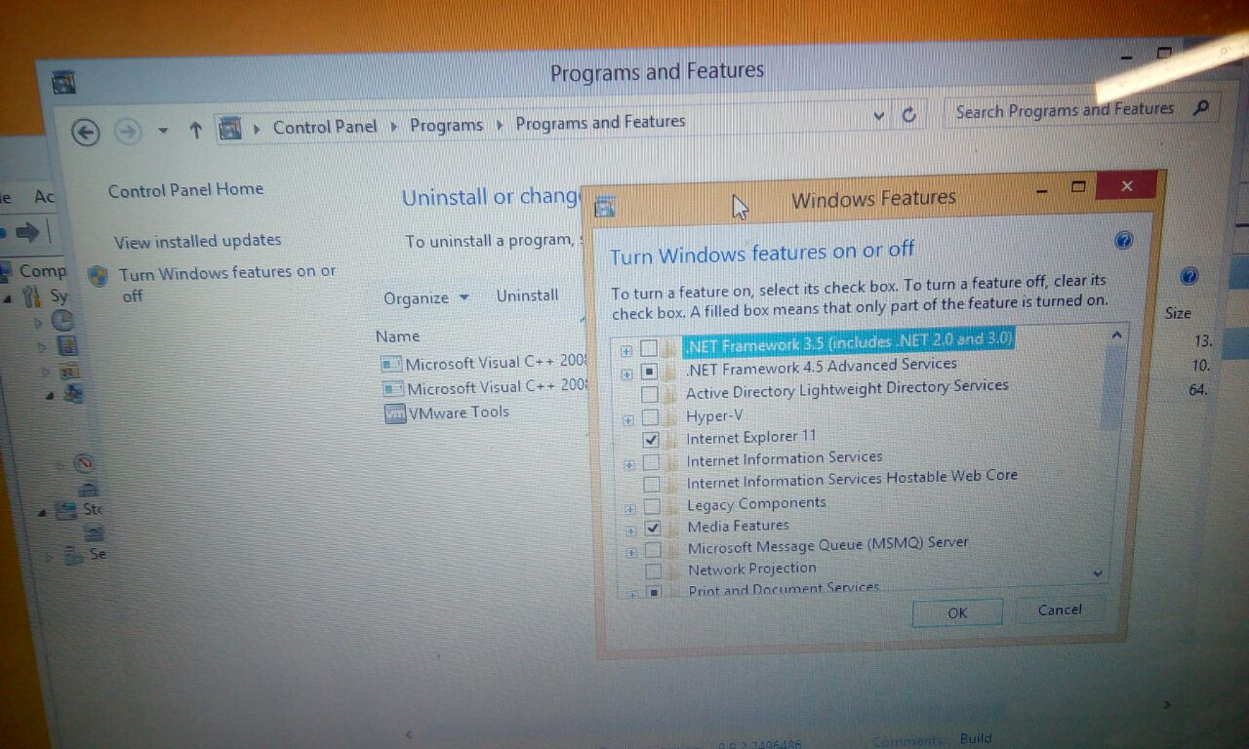
Go to windows features in Programs and features.

Slide 20
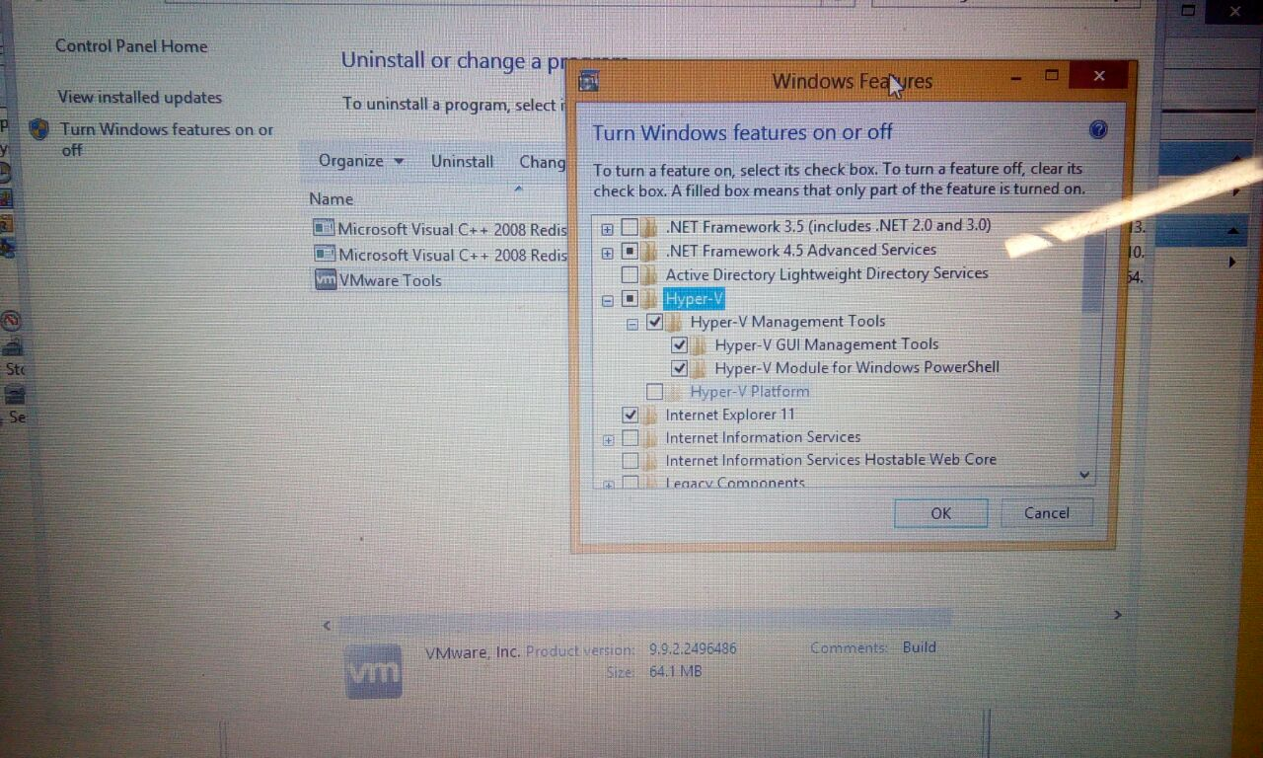
Install Hyper-v management tools.

Slide 21
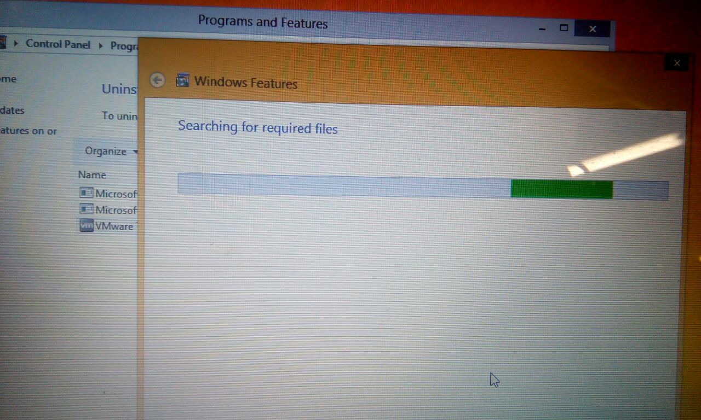
It will search for required files online.

Slide 22
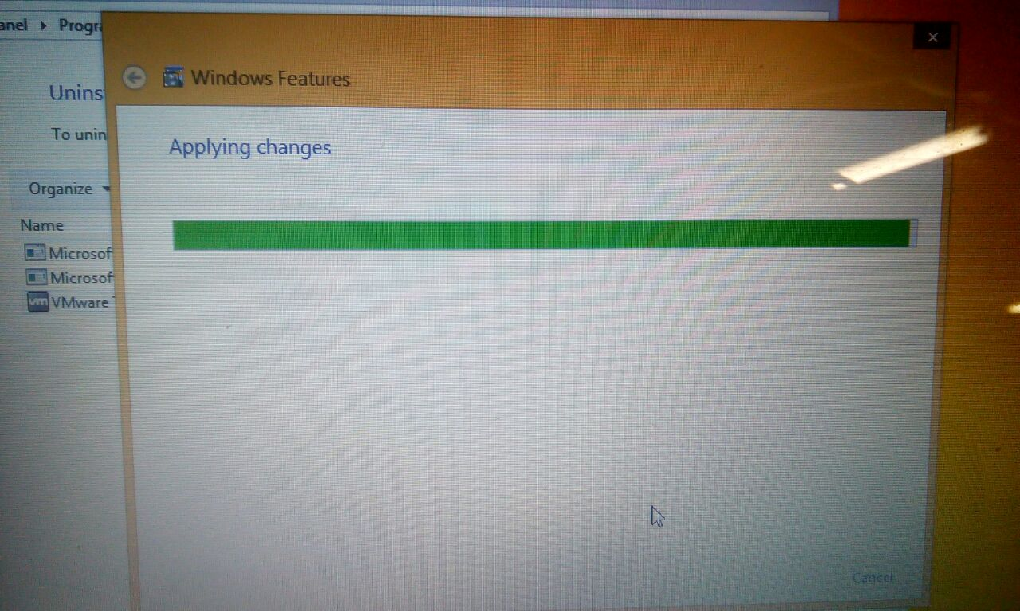
Windows will start applying these changes.

Slide 23
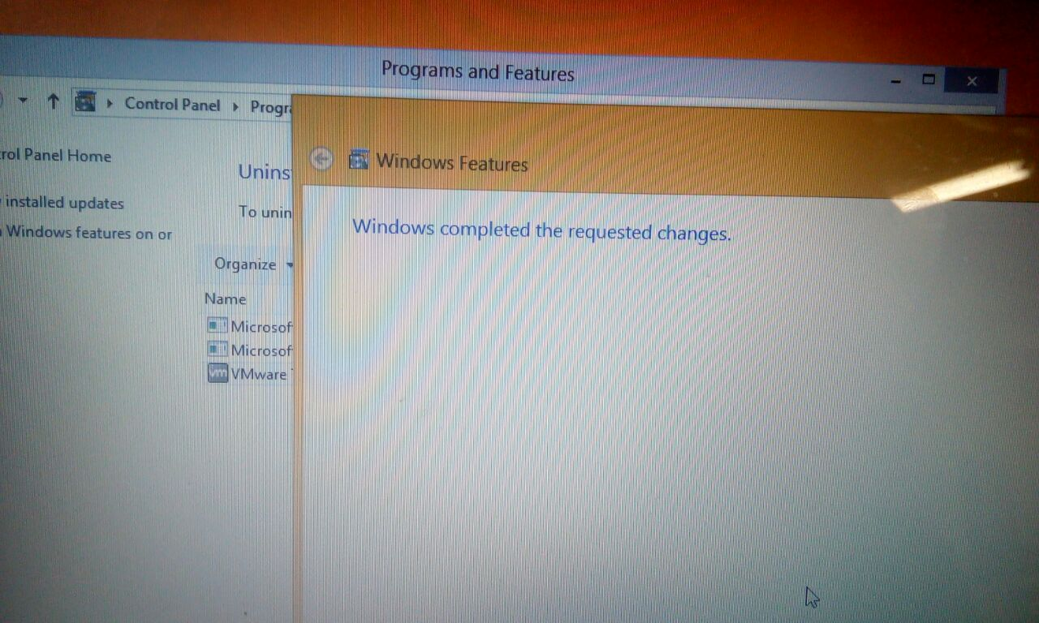
Click on Close button when you see Windows completed requested changes.

Slide 24
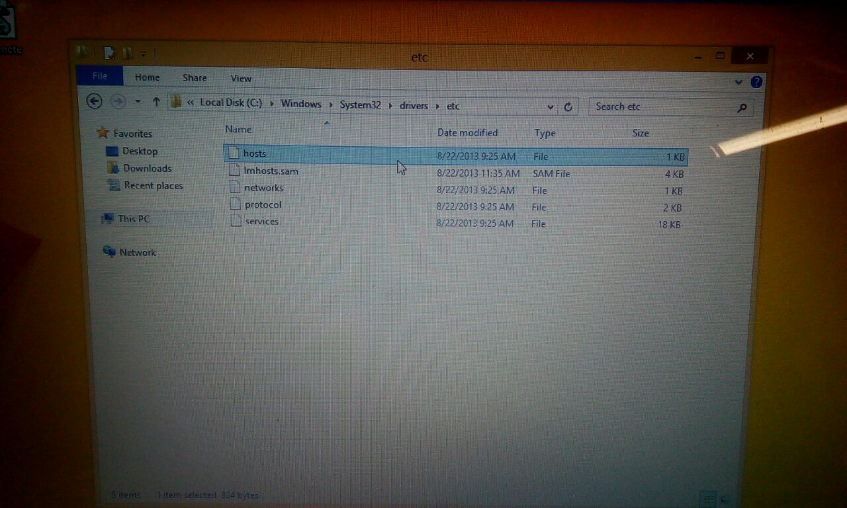
Then logon on as admin and go to C\Windows\System32\Drivers\etc and open hosts file.

Slide 25
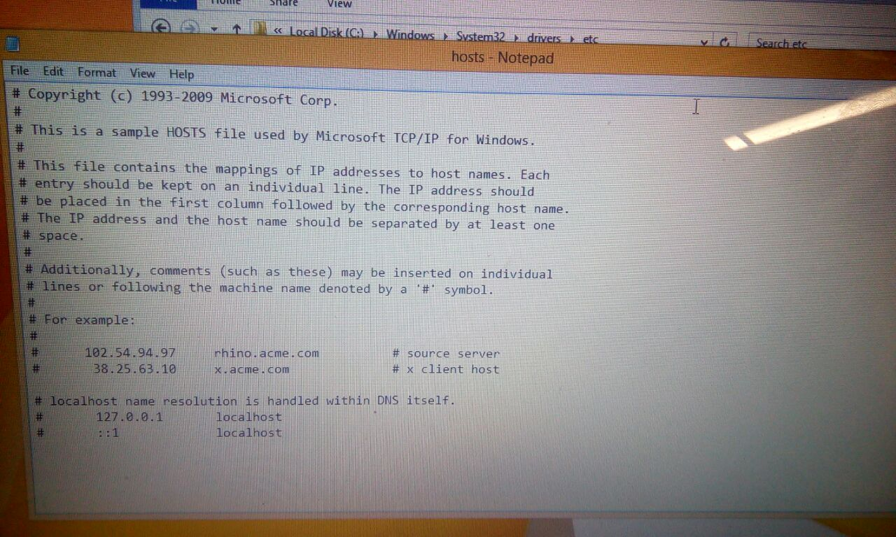
Navigate to the end of this file .

Slide 26
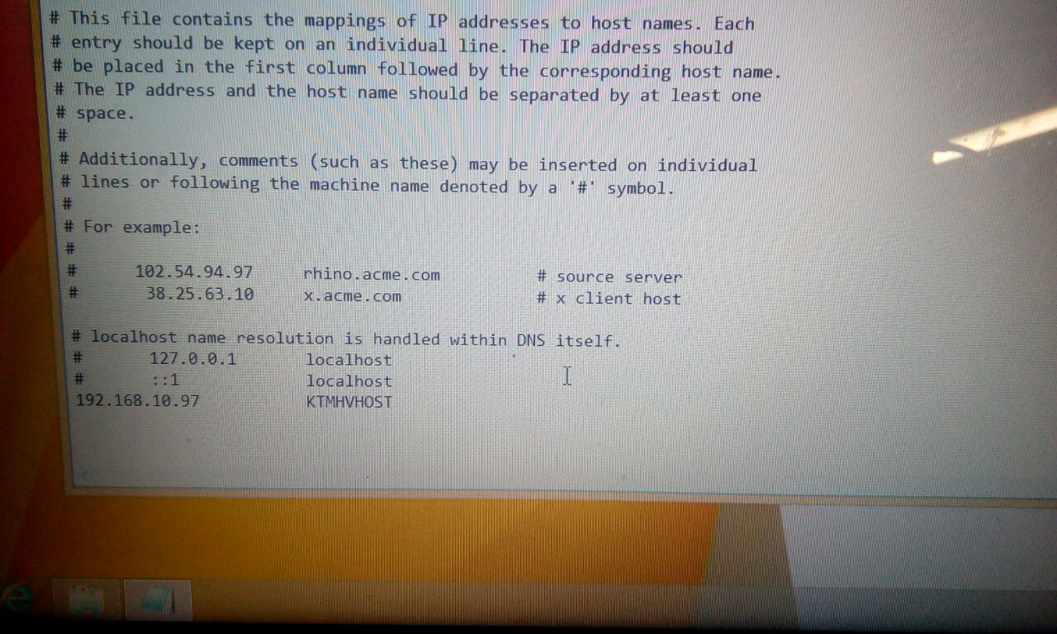
Edit it with the command written below and save it.

Slide 27
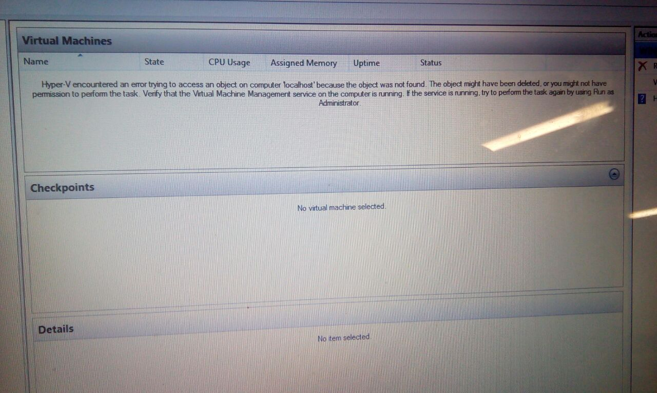
Then open the Hyper-V Manager console.

Slide 28
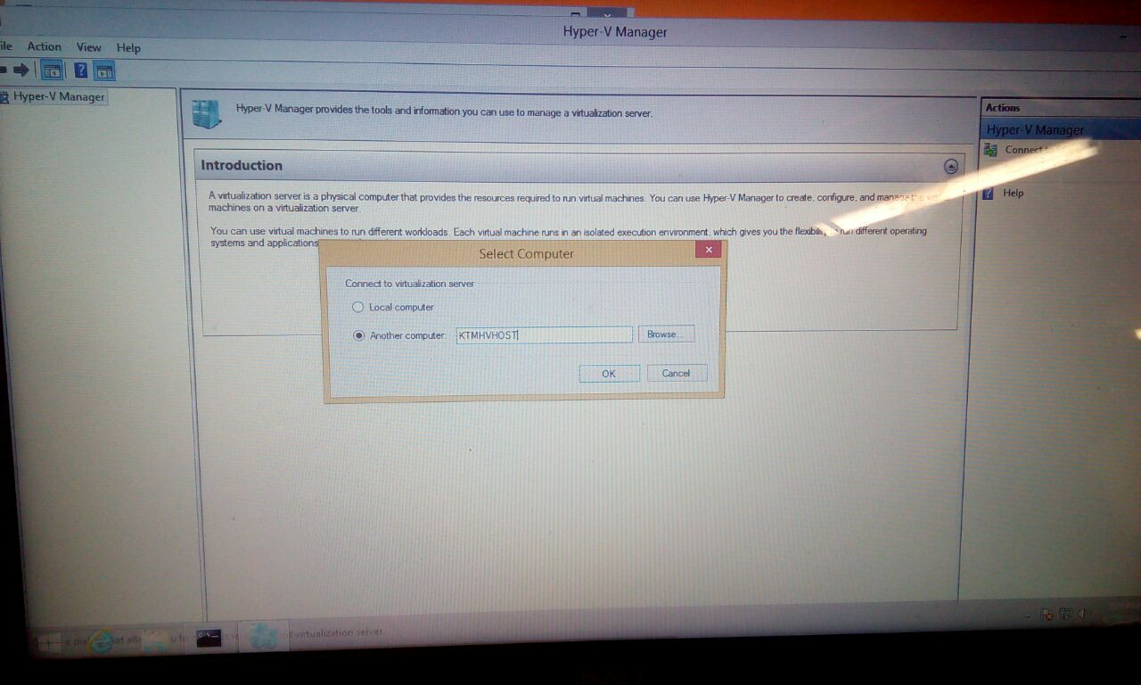
Then click on connect to server select a specified server and select he computer. Click OK and you are then ready to manage Hyper-V server Remotely.

